Slide 1
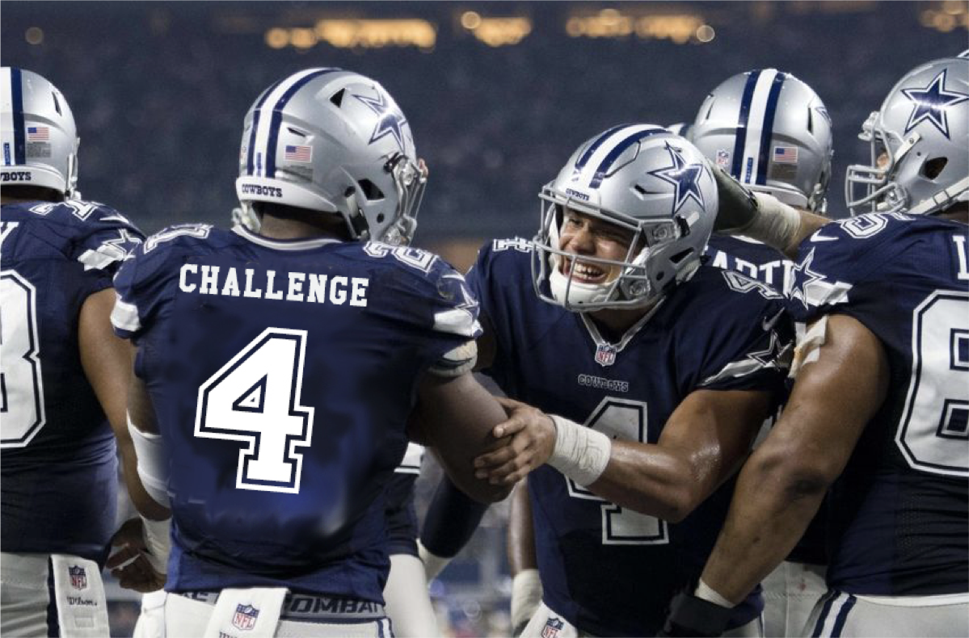
Palfinger as a Service
Team Dallas Cowboys

Slide 2
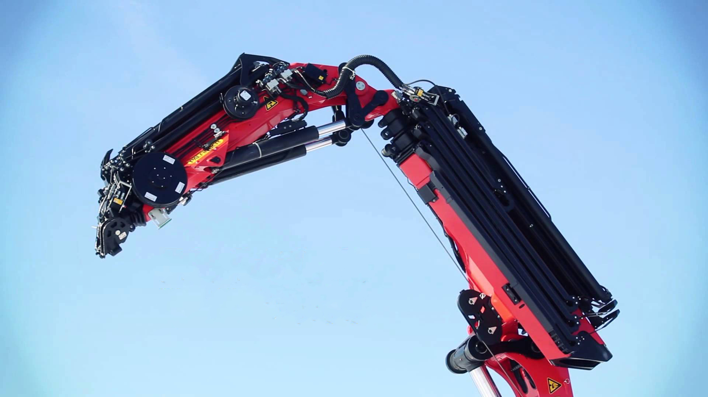
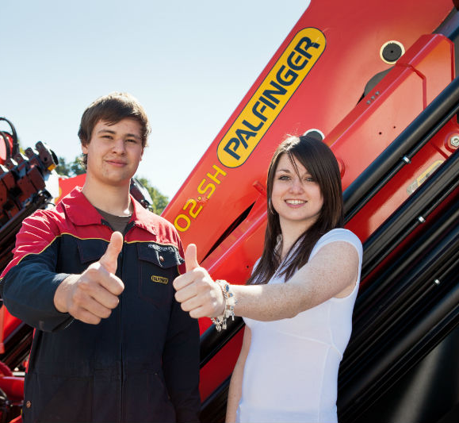
DIGITAL TRANSFORMATION
WIRD
Machine Provider
Service Provider
MachineProvider

Slide 3
SHOWCASE

Slide 4
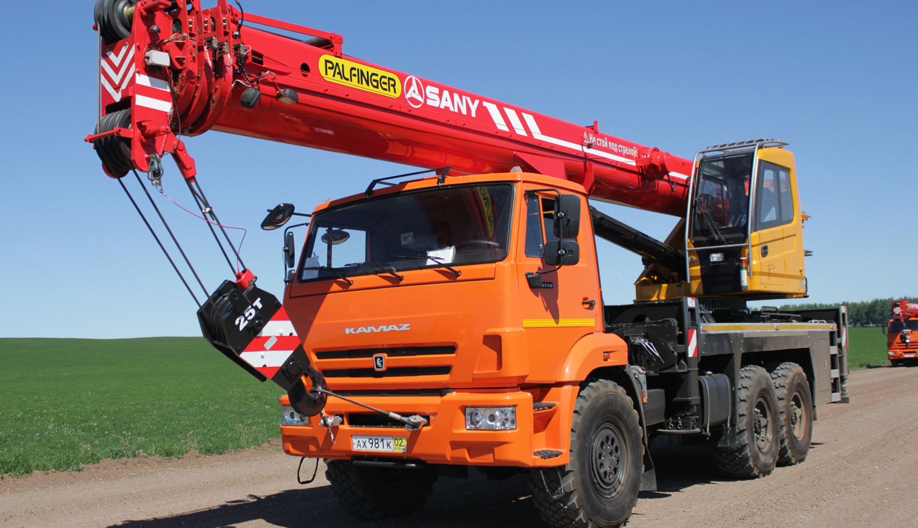
BENEFITS
Local Support
Efficient Service
Remote Support
Software Rollout
Future Proof
Share Economy

Slide 5
Team Dallas Cowboys Thank you
All code and presentation:
github.com/FabianHippmann/palfinger-hackathon

Slide 6
ZUSATZINFOS

Slide 7
Team
Florian Bauer (florian@sbg.at)
Fabian Hippmann (fabianhippmann@gmail.com)

Slide 8
TechStack
Laravel (PHP, Apache, Mysql)
NodeJS (Aws, Lambda, Cloudwatch, Alexa Skill Set)
Mitmproxy (Proxy for Palfinger App APIs)
OnSite Device
Echo Dot
Voice Output
Speech Recognition
AWS Lambda Service
Palfinger
Assistance Hub
Extranet Palfinger.com
WIRD

Slide 9
Testpilot
Phase 1: New Horizon
Conception of specific Usecase and Service Request
Development of possible User Intents, Testing with regards to Surrounded Noise and Environment of workers
Defined Usecase with a partner to see usage and impact
Estimated Project Time: 2 months
Goal of Project: Does a Voice Interface speed up service fulfillment.
Phase 2: Expansion
Additional Usecases, Secure Gateway to Crane operating System

Slide 10
Links
Application: http://phplaravel-34738-81763-225945.cloudwaysapps.com/
https://developer.amazon.com
https://eu-west-1.console.aws.amazon.com/cloudwatch
https://eu-west-1.console.aws.amazon.com/lambda/
https://aws.amazon.com/blogs/compute/nodejs-packages-in-lambda/
https://github.com/alexa
https://forums.developer.amazon.com

